Slide 1

LESSON 2

Slide 2


Slide 3


Slide 4


Slide 5


Slide 6


Slide 7

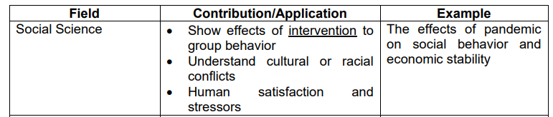

Slide 8
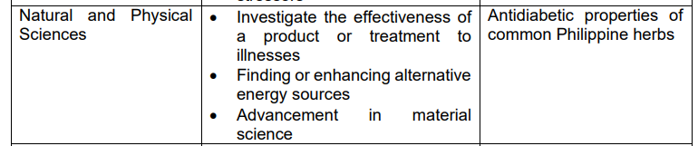

Slide 9
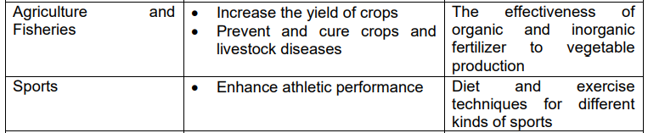

Slide 10
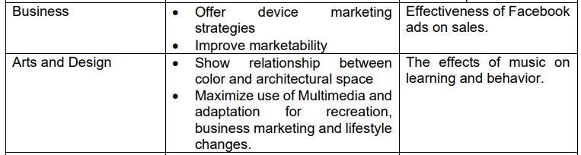

Slide 12
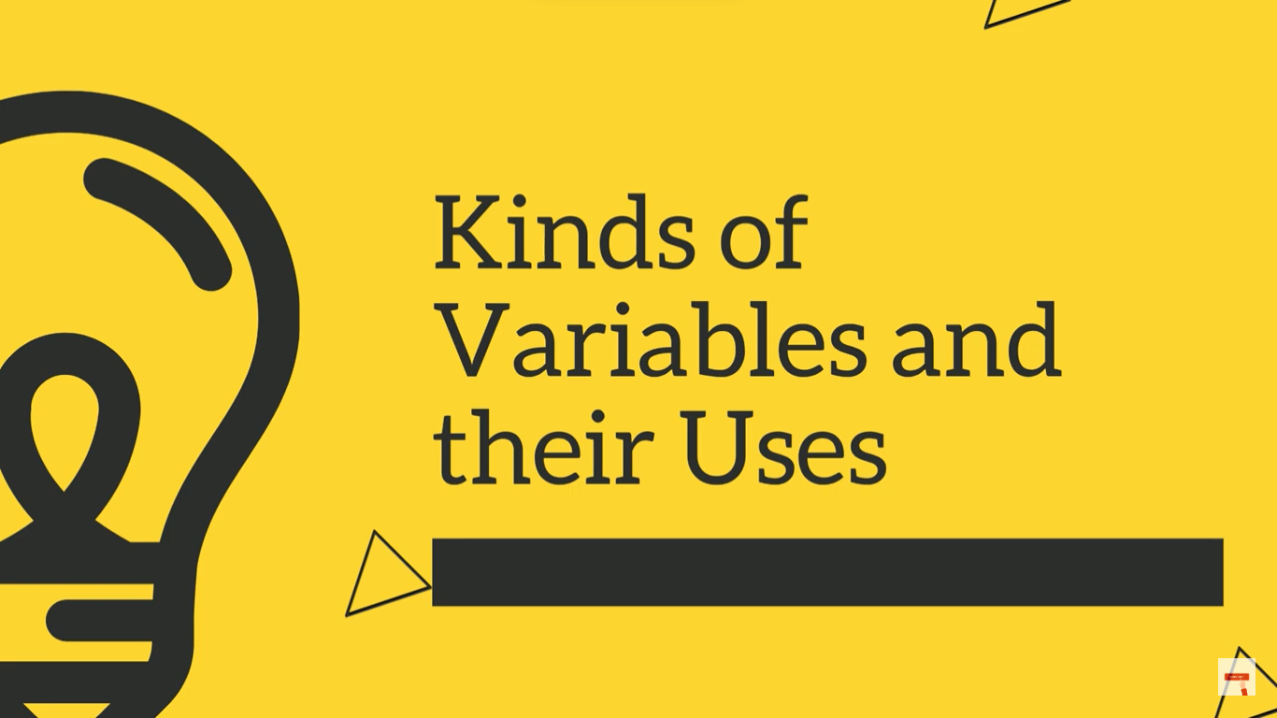
Identify in what field does the following inventions, innovations or discoveries belong.

Slide 13
1. VACCINE
2. REFRIGERATION
3. PRINTING PRESS
4. COMPUTER
5. AIRPLANE
6. PHOTO FINISHES
7. SOCIAL MEDIA
8. PAINT

Slide 15
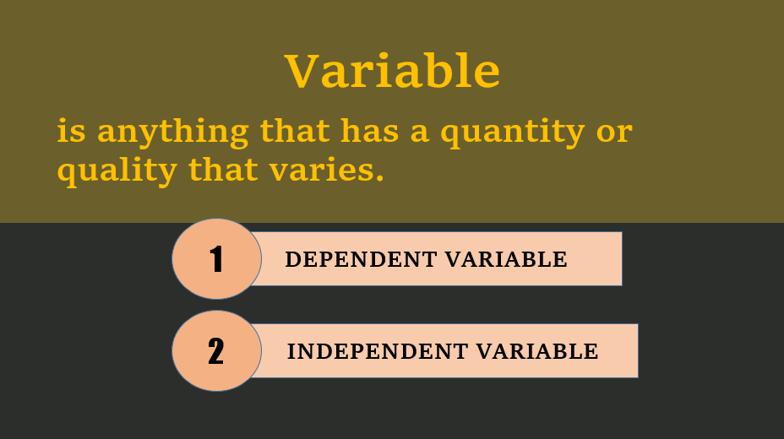

Slide 16
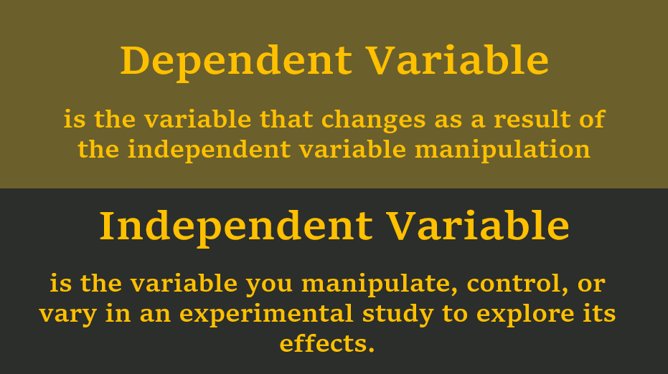

Slide 17
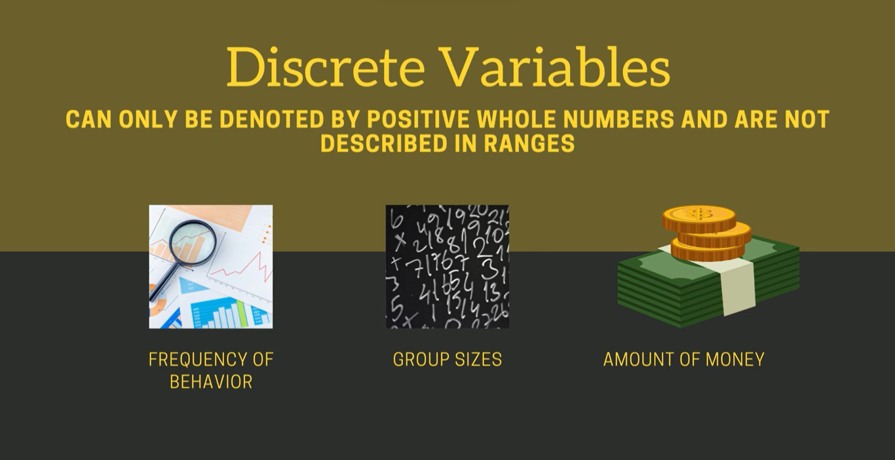
Dependent Variable
is the variable that changes as a result of the independent variable manipulation
Independent Variable
is the variable you manipulate, control, or vary in an experimental study to explore its effects.

Slide 18
time spent for working and salary
IV:
time spent for working
DV:
salary

Slide 19
number of hours boiling and the number of ounces of water in the pot
IV:
Number of ounces of water
DV:
Number of hours boiling

Slide 20
distance covered and the number of liters of the gasoline left
IV:
No. of liters of the gasoline
DV:
Distance covered

Slide 21
number of bottles of ink needed and number of pages to be printed
IV:
No. of pages to be printed
DV:
No. of bottles of ink

Slide 22
Dependent Variable
Growth of tomatoes
Independent Variable
sunlight, water, and nutrients in the soil

Slide 23
Extraneous Variable
factors that may influence the outcome (dependent variable) not manipulated or pre-defined by the researcher

Slide 24
Confounding Variable
The result when the researcher fails to control the extraneous variable that it caused considerable effect to the outcome

Slide 25


Slide 26
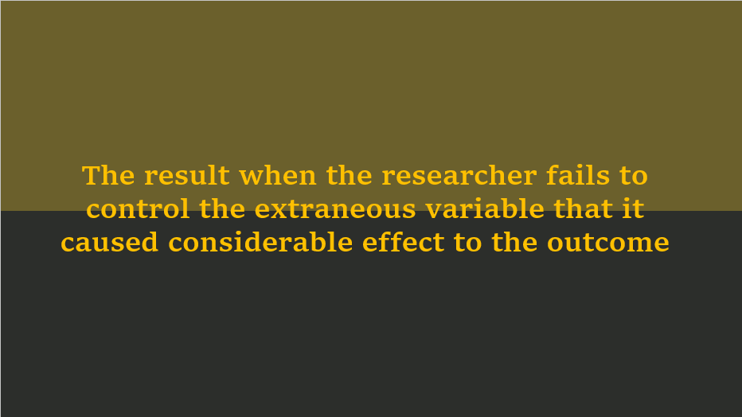

Slide 27
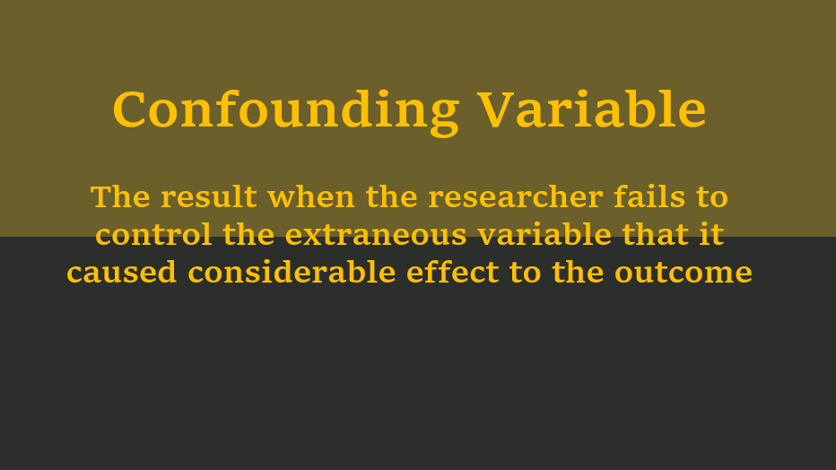

Slide 28
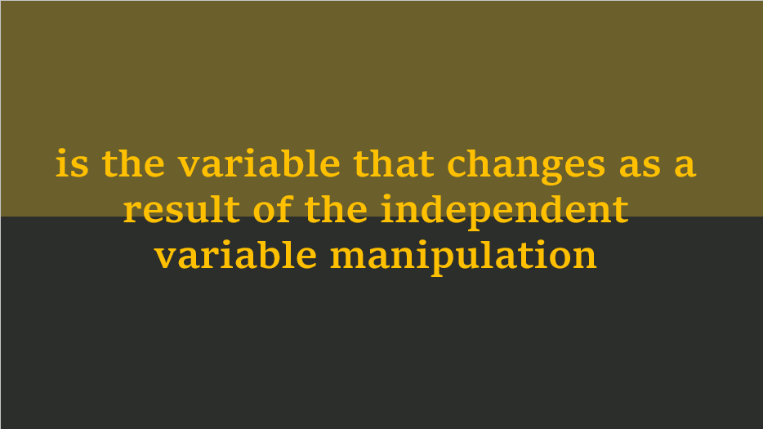

Slide 29
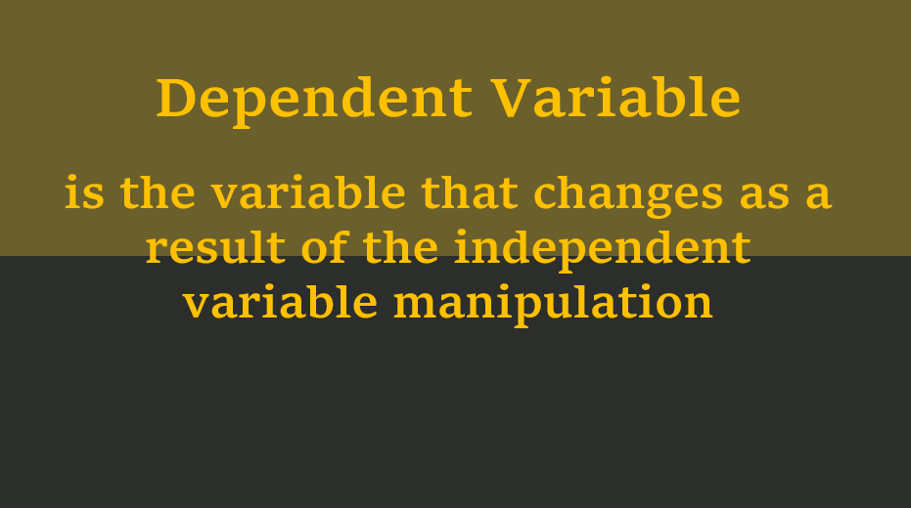

Slide 30
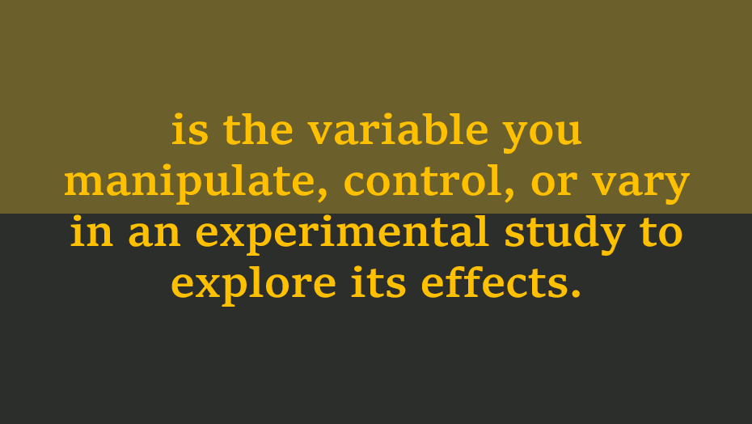

Slide 31
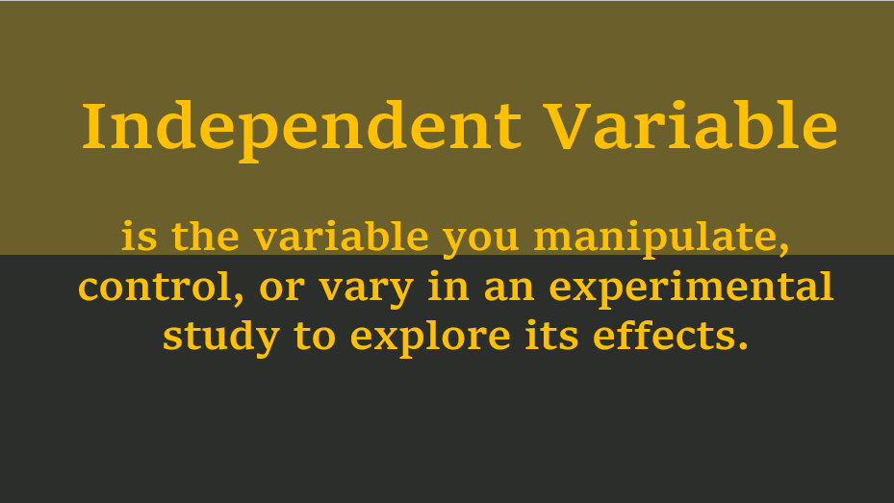

Slide 32
factors that may influence the outcome (dependent variable) not manipulated or pre-defined by the researcher

Slide 33
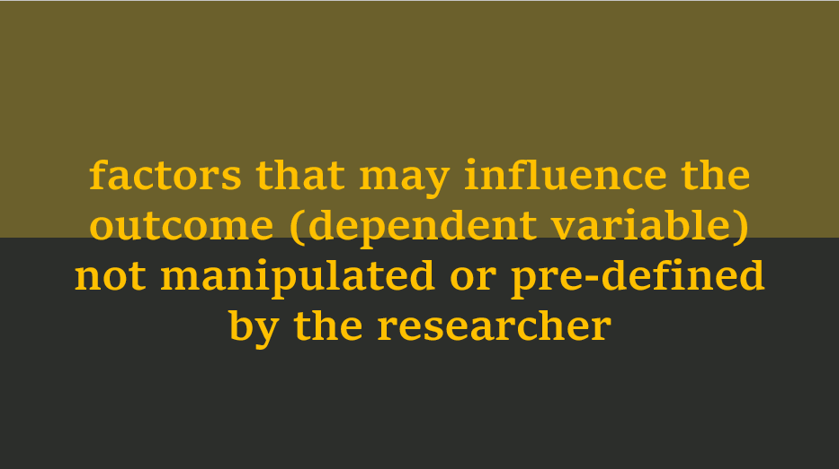

Slide 34
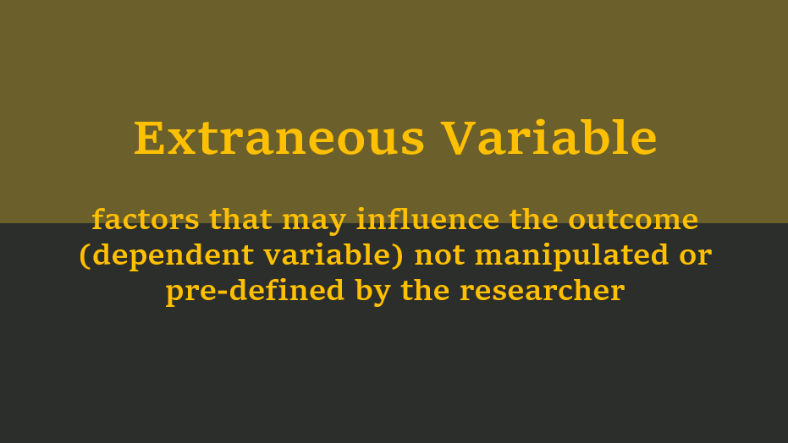

Slide 35
A housewife wanted to know which soil is best for her pechay plants: the soil purchased from an online seller, soil from her backyard compost or the soil underneath the nearby bamboo tree. She planted 30 pechay seeds into each soil source and then compared the growth of pechay after a month.

Slide 36
IV:
Source of Soil
DV:
Growth of pechay
EV:
Weather condition
Pests

Slide 37
Music is a very powerful stimulus. Many people like to listen to music when they are engaged in an athletic activity, such as running or lifting weights.

Slide 38
IV:
Music
DV:
Weight-Lifting Ability
EV:
Fitness level

Slide 39
several factors are affecting the growth of tomatoes: sunlight, water, kind of soil, and nutrients in soil.
IV:
amount of sunlight, water, and nutrients in the soil
DV:
Growth of tomatoes

Slide 40
several factors are affecting the growth of tomatoes: sunlight, water, kind of soil, and nutrients in soil.
EV:
pests, extreme weather

Slide 41
Three groups of students were placed in a classroom with controlled room temperatures of 18°C, 20°C, 25°C. The math exam scores of the students were then taken and compared to the other groups.

Slide 42
Three groups of students were placed in a classroom with controlled room temperatures of 18°C, 20°C, 25°C. The math exam scores of the students were then taken and compared to the other groups.
IV:
Room Temperature
DV:
Math Exam Scores
EV:
Student’s IQ/Abilities

Slide 43
An online seller would like to know whether the indication of price on Facebook posts will attract consumers more. He posted 50 products for sale on Facebook market, 25 of which he indicated the price while the remaining 25 products, did not have prices. Buyers were just instructed to send him a personal message (pm) if they want to know the price. He then identified which products have greater sales

Slide 44
IV:
FB Posts
DV:
Sales
EV:
Product Quality
Current Economic Status

Slide 45
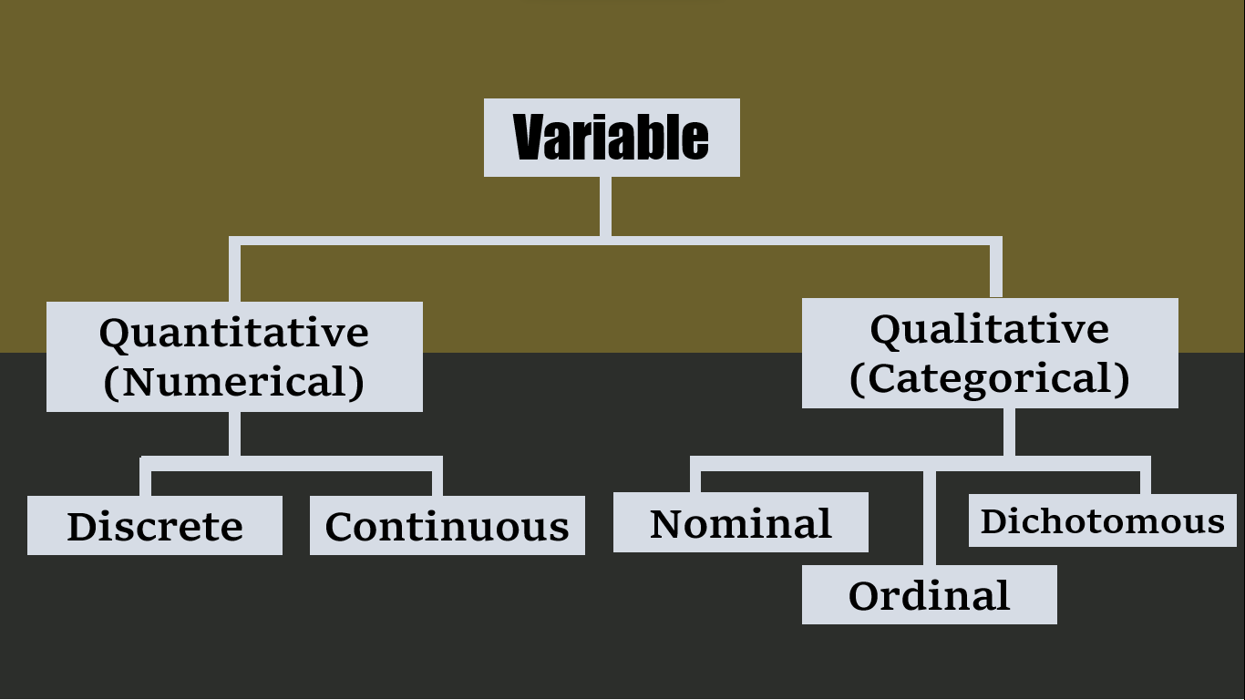

Slide 46


Slide 47
Quantitative Variables
also called numerical variables, are the type of variables used in quantitative research because they are numeric and can be measured

Slide 49
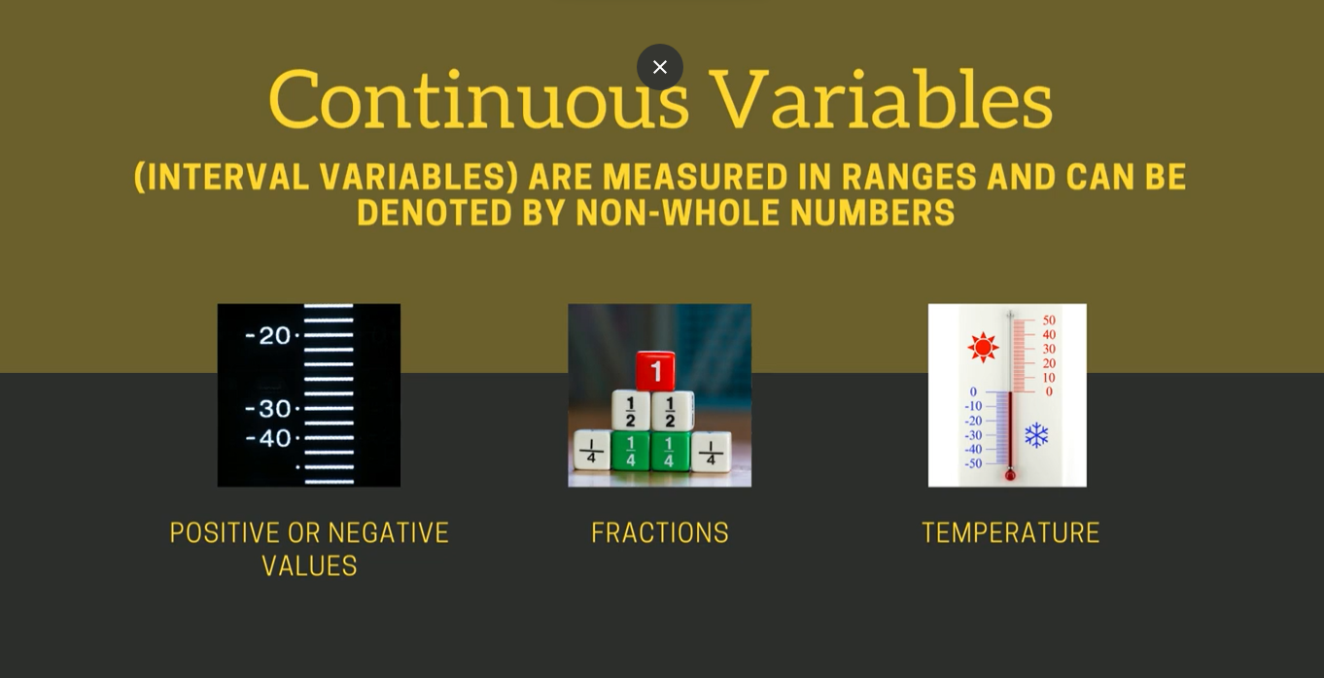

Slide 50
Numerical data have two levels of measurement:

Slide 51




Intervals
the interval or differences between consecutive values are equal and meaningful, but the numbers are arbitrary
TEMPERATURE
IQ
TIME
DATES

Slide 52
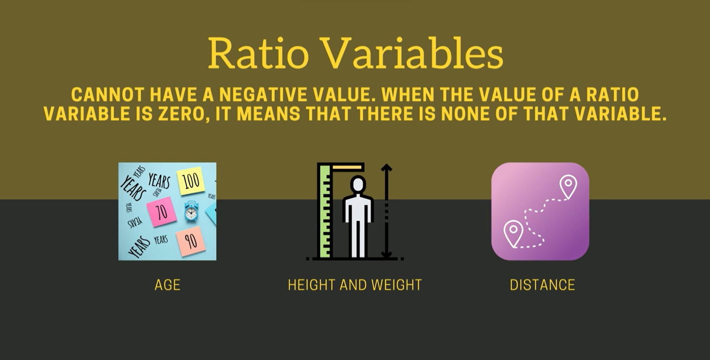


Slide 53
Qualitative Variables
also referred to as Categorical Variables are not expressed in numbers but are descriptions or categories.

Slide 54


Slide 55
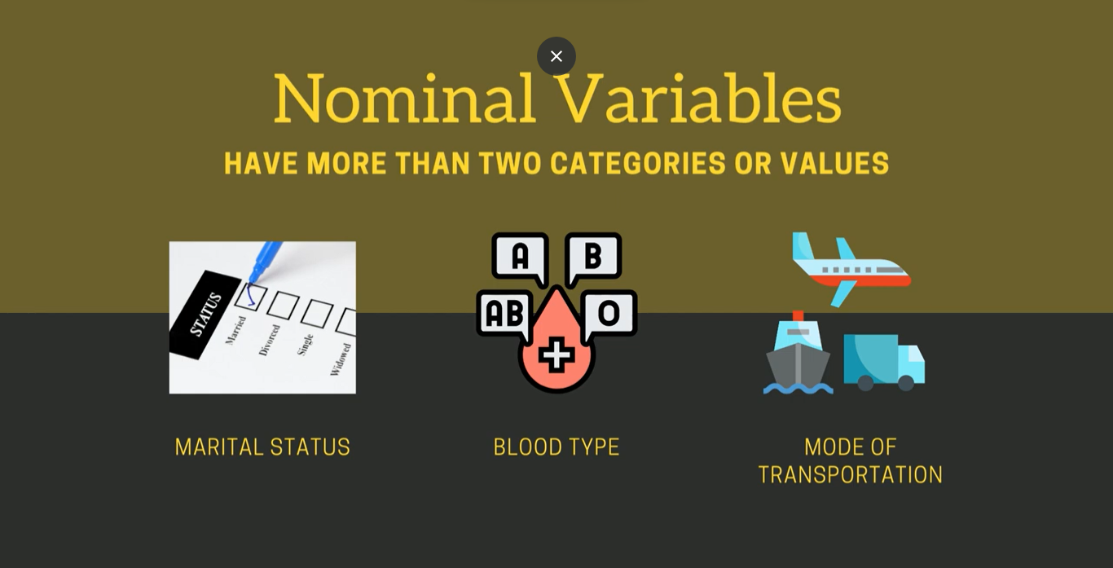

Slide 56


Slide 57



Slide 58



